Slide 1
Basic Principles
in Networking
Assignment 1: Wifi Measuring
Pair 6: Huy Le (903026), Duong Tran (789017)

Slide 2
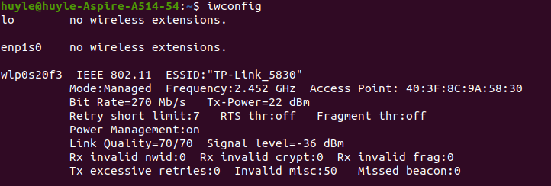
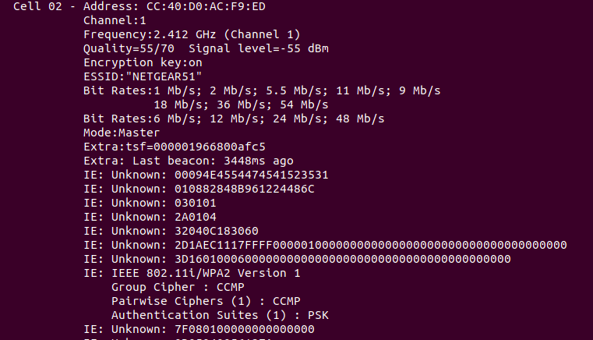
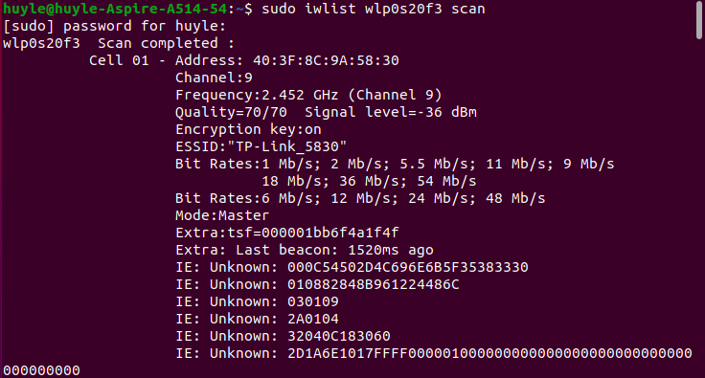
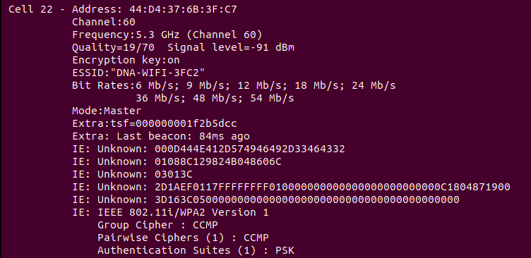
1, Check Wifi interface network configuration
Use command line “iwconfig” to show the configuration of the connected Wifi interface (Fig. 1)
2, Scan Wifi access points (APs)
Use command line “sudo iwlist wlp0s20f3 scan” to scan all available APs. (Fig. 2, Fig. 3, Fig. 4)
Each “Cell” displays information on each AP, including SSID, BSSID (Address), used channel, band, network protocol, supported data rates (Bit rates), signal strength (Signal level), and other information.
Fig. 3
Fig. 1
Fig. 4
Fig. 2

Slide 3
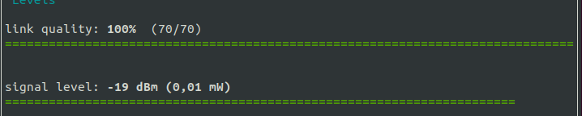
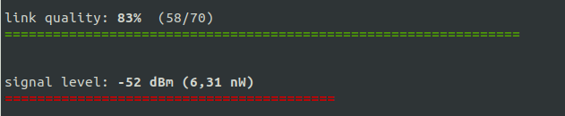
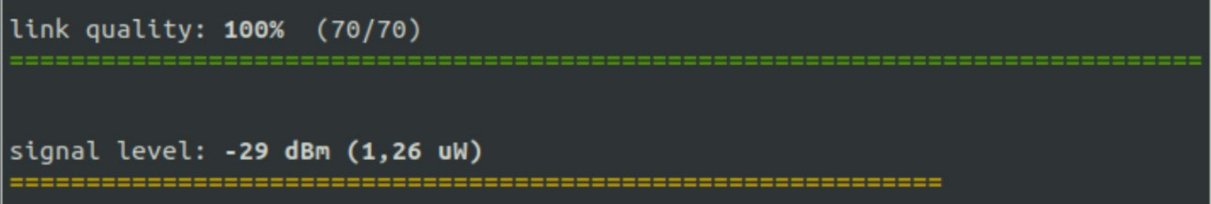
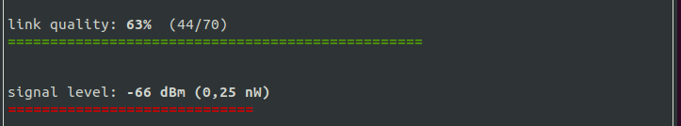
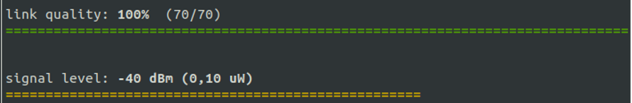
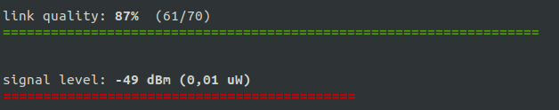
3, Changes in signal strength based on distance and obstacle
We installed and used Wavemon (using “sudo apt-get install wavemon”) for real-time measurement of signal strength
No obstacle, distance:
With obstacle (wall/closed door), distance:
Fig. 5: 0m
Fig. 9: 7m
Fig. 6: 2m
Fig. 10: 12m
Conclusion:
The greater the distance, the weaker the signal strength
Obstacles (such as a wall, a closed door, etc.) weaken the signal strength
Obstacles seem to influence the signal strength more significantly than distance.
Fig. 7: 7m
Fig. 8: 12m

Slide 4
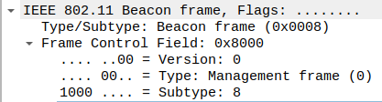

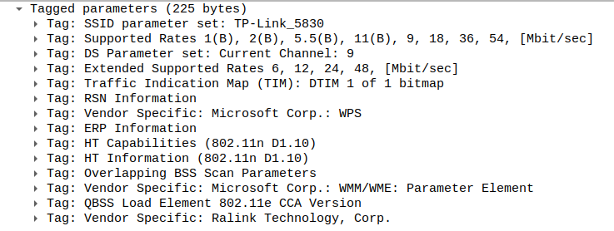
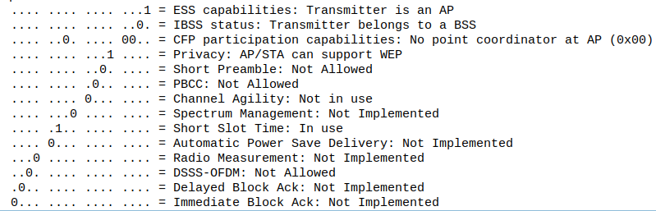
4, Parse the beacon frames
To parse the beacon frames, we set the wireless interface to monitor mode before using Wireshark:
Open a new Wifi network interface, type “iwconfig” to get the current wireless interface name, in this case wlp0s20f3
Type “sudo iw dev wlp0s20f3 interface add mon0 type monitor ” and “sudo ip link set mon0 up” to create a separate wireless interface mon0 in monitor mode
Open Wireshark, capture mon0 interface and use the filter “wlan.fc.type_subtype == 0x8” to capture the beacon frames.
Fig. 11: Filter beacons on Wireshark
Fig. 13: Beacon Interval
Fig. 12: Beacon Frame Control Field
Fig. 14: AP’s MAC address
Fig. 15: Information on AP (similar to that in question 1)
Fig. 16: Proof that beacon is transmitted by an AP

Slide 5
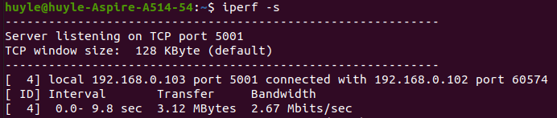
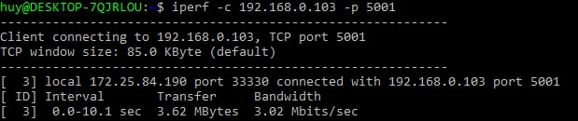
5, Measure data rate with 2 stations connected to the same AP
Connect both stations to the same AP. Select a station to be server and the other to be client.
On the server station, type in command line “ifconfig” to get the private IP address. Then, type “iperf -s” to set it as server. (Fig. 17)
On the client station, type in command line “iperf -c 192.168.0.103 -p 5001”, where “-c” is followed by the server’s IP address, and “-p” is followed by the port displayed by the server. (Fig. 18)
Fig. 17: Station set to server station
Fig. 18: Station set to client station
Fig. 19: Data rate measured on server station
Fig. 20: Data rate measured on client station

Slide 6
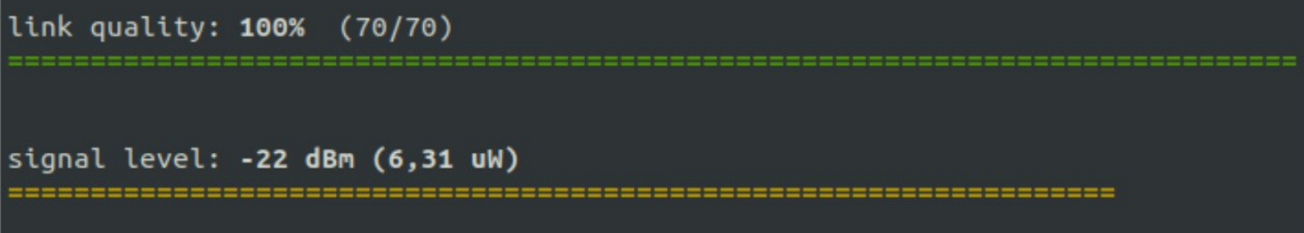
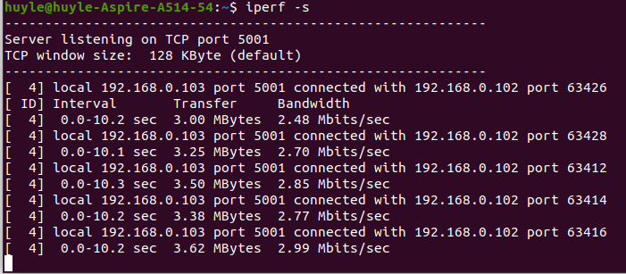
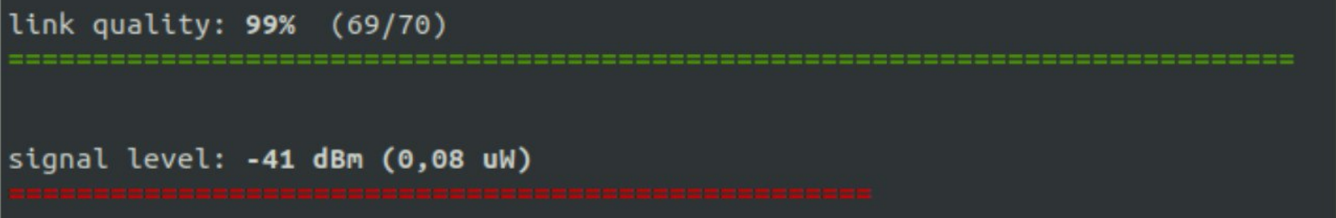
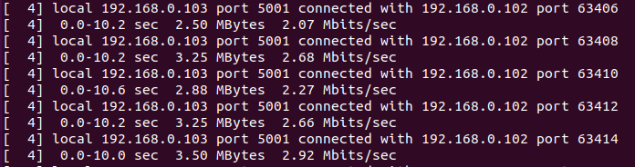
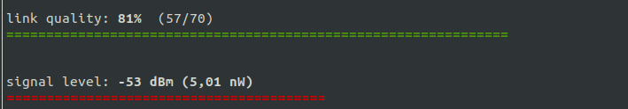
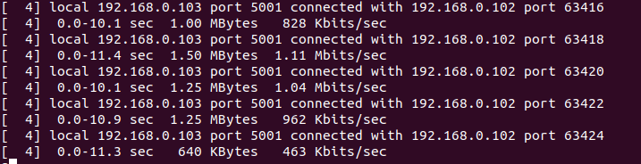
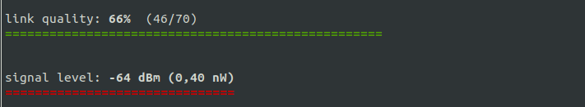
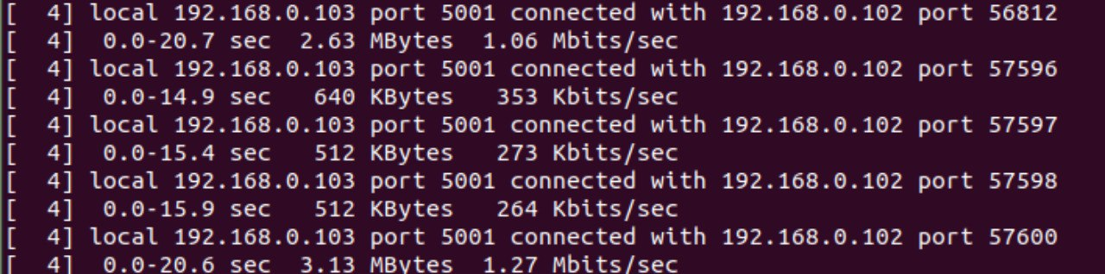
6, Impact of signal strength on data rate
To analyze the impact of signal strength on data rate, we measured the data rate (with the same server-client method) in different configurations that result in different signal rate, specifically positions with different distances to the AP (which is a method of altering signal strength as demonstrated in question 3).
Conclusion:
In the distance of around 0m to 7m from the AP, the data rate, though experiences a slight decrease, stays relatively stable in an optimal range of around 2 to 3 Mbits/sec. Data rate would decrease significantly outside this range, staying at around only 1 Mbits/sec at 12m.
Outside the optimal range, data rate decreases with signal strength, and the effect of obstacles and distance is much more significant. The data transfer interval between 2 also increases.
Fig. 21: 0m from the AP
Fig. 22: 7m from the AP
Fig. 23: 12m from the AP (door open)
Fig. 24: 12m from the AP (door closed)

Slide 7
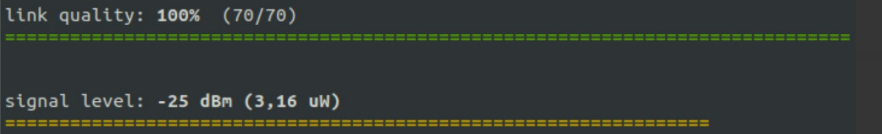
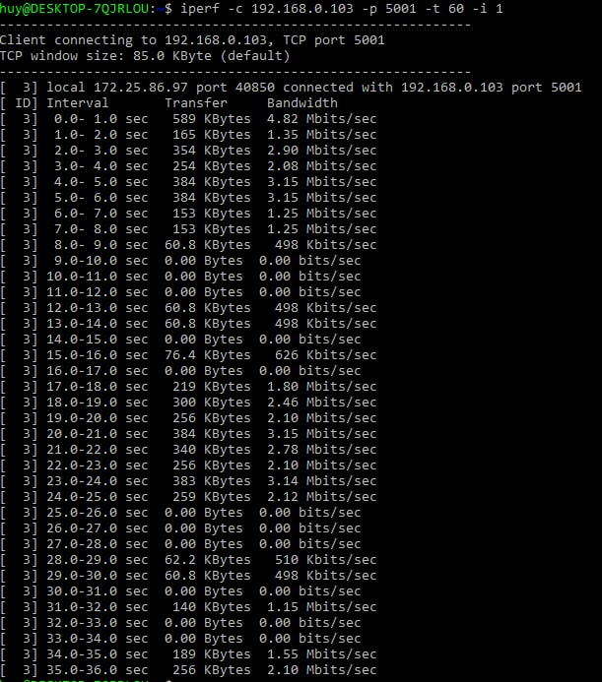
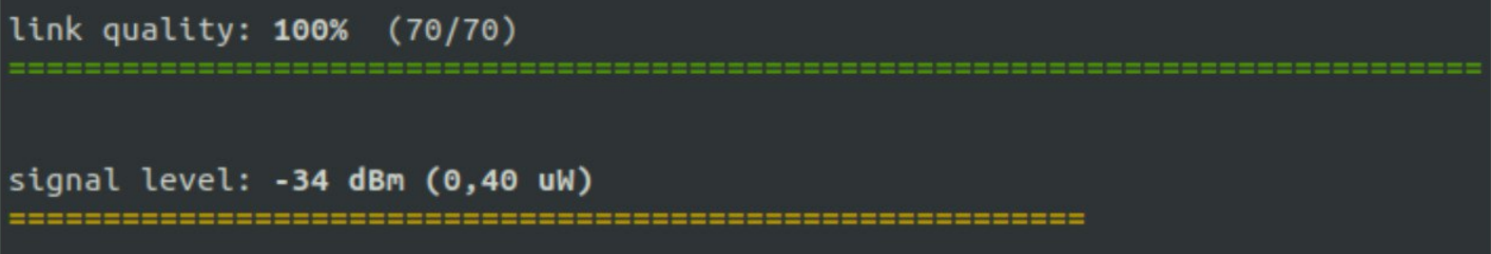
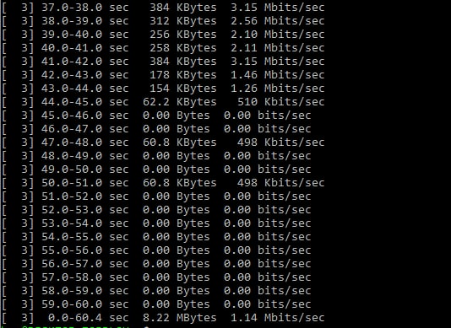
7, Impact of interference on throughput
To analyze the impact of interference on throughput, we measured the signal level and data rate at different distances to the AP. The interference will be created by running a microwave, and throughput will be measured at distances with and without the interference.
We used the server-client method to measure throughput, but we used the command line “iperf -c 192.168.0.103 -p 5001 -t 60 - i 1” to display the values continuously in a 60-second interval. Note that the microwave is placed at 2m from the AP, and the client station is next to the AP.
Distance to microwave
Microwave off
Microwave on
0m
2m
5m
Conclusion:
Note that our device could not measure noise level and SNR, but it could be derived from the measurements that signal strength is relatively unaffected by interference. The real impact is on SNR ratio, which is not displayed here, but illustrated by the measurement of throughput. It is evident that data rate is heavily influenced and even dropped to 0 in-between when interference is created.
Hence, the stronger interference is, the lower and weaker throughput becomes.

